Slide 1


Gabin DJOMO NKUIGWA
09, Nov 2022

Slide 2

Outline
Executive Summary
Introduction
Methodology
Results
Conclusion
Appendix

Slide 3
Executive Summary
To carry out this project, we borrowed the following road
Project understanding
Know the Goal
Know the motivation
Summary of methodologies
Data (Collection / Understanding / Preparation)
Location Launch
Machine Learning Models
Summary of all results
Data Wrangling
Launch site map location
Static and interactive visualization
Machine Learning Prediction

Slide 4
Introduction
In this study, the objective was to predict whether the Falcon 9 first stage will land successfully
If we can determine if the first stage will land, we can determine the cost of a launch
In this study, we will approach many concepts that we will see below
We will present our research to you and we will discuss the findings

Slide 5

Section 1

Slide 6
Methodology
Executive Summary
Data collection methodology:
Describe how data was collected
Perform data wrangling
Describe how data was processed
Perform exploratory data analysis (EDA) using visualization and SQL
Perform interactive visual analytics using Folium and Plotly Dash
Perform predictive analysis using classification models
How to build, tune, evaluate classification models

Slide 7
Data Collection
The data is taken from a csv file placed in a remote server or through their official website
We use an REST API which will connect to the remote platform to allow us to extract the data
First, our work was done on Jupyter Notebook code editor
We used its built-in API which provided us with an interface between the editor and remote data sources.
We connected to the data and extracted it
They are stored in a data frame

Slide 8
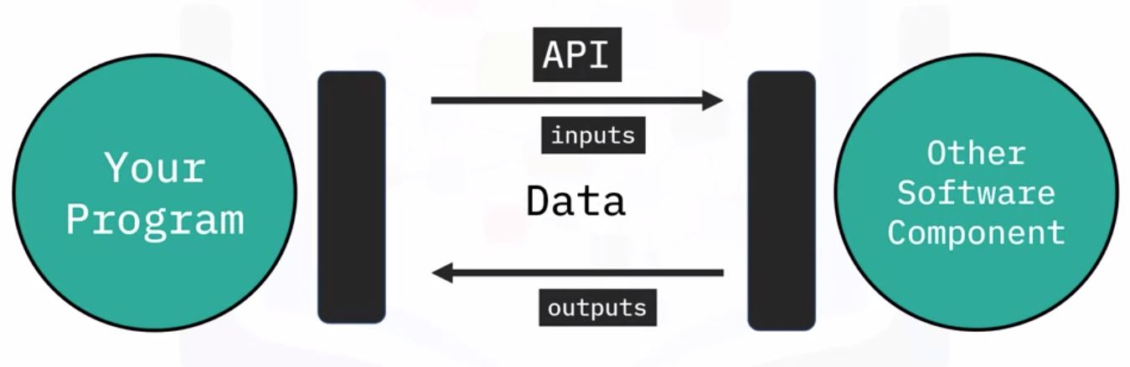
Data Collection – SpaceX API
Our program use an API integrated to communicate with the remote server to get the file historical launch data and load it into the data frame, to handle late.
This is the GitHub URL of the completed SpaceX API calls notebook https://github.com/DJOMOgabin/IBM-Project-Capstone/blob/master/jupyter-labs-spacex-data-collection-api.ipynb

Slide 9
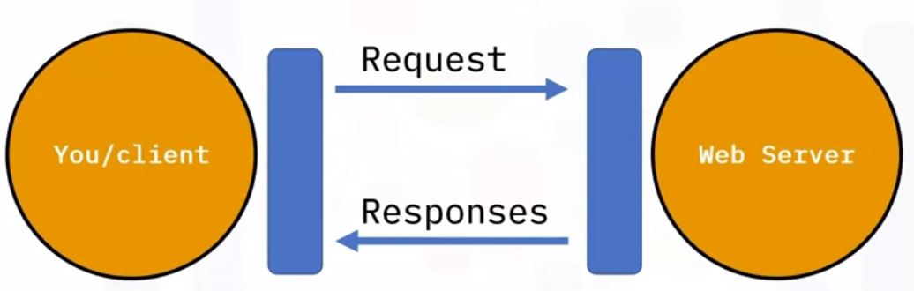
Data Collection - Scraping
Our program use an WebScraping Library (Beautifulsoup) to communicate with web pages to get the launch data and load it into the data frame, to handle late.
This is the GitHub URL of the completed web scraping notebook https://github.com/DJOMOgabin/IBM-Project-Capstone/blob/master/jupyter-labs-webscraping.ipynb

Slide 10
Data Wrangling
Data cleaning is done by pruning all unnecessary data
We identify and mitigate the impact of missing data
After do this, we Exploratory Data Analysis (EDA)
We determinate training labels
We normalize data
This is the Github link of the completed Wrangling Notebook https://github.com/DJOMOgabin/IBM-Project-Capstone/blob/master/labs-jupyter-spacex-Data%20wrangling.ipynb

Slide 11
EDA with Data Visualization
The plots that are presented are as follows :
We plot FlightNumber vs PayloadMass in scatter plot to see how these variables would affect the launch outcome
We plot FlightNumber vs LaunchSite in scatter plot to see how these variables would affect the launch outcome
We plot PayloadMass vs LaunchSite in scatter plot to see how these variables would affect the launch outcome
We plot Orbit vs Class to visually check if there are any relationship between these variables
Etc…
Visualize the launch success yearly trend
https://github.com/DJOMOgabin/IBM-Project-Capstone/blob/master/jupyter-labs-eda-dataviz.ipynb

Slide 12
EDA with SQL
SQL Queries
total payload mass carried by boosters launched by NASA (CRS)
average payload mass carried by booster version F9 v1.1
the date when the first succesful landing outcome in ground pad was acheived
the names of the boosters which have success in drone ship and have payload mass greater than 4000 but less than 6000
the total number of successful and failure mission outcomes
the names of the booster_versions which have carried the maximum payload mass
https://github.com/DJOMOgabin/IBM-Project-Capstone/blob/master/jupyter-labs-eda-sql-coursera_sqllite.ipynb

Slide 13
Build an Interactive Map with Folium
map object we created:
We have located all launch sites on the map
We added a circle around it to circumscribe the launch site
We have added markers to highlight all the launches that have been made on this site, the color differentiates if the launch was a success or a failure
Lines have been added to represent the between one point and another
https://github.com/DJOMOgabin/IBM-Project-Capstone/blob/master/lab_jupyter_launch_site_location.ipynb

Slide 14
Build a Dashboard with Plotly Dash
We plot:
Total success launches all sites
Success rate launches for each site
Correlation between Payload and Success for all sites in Range of Payload Mass
Correlation between Payload and Success for each site
https://github.com/DJOMOgabin/IBM-Project-Capstone/blob/master/spacex_dash_app.py

Slide 15
Predictive Analysis (Classification)
Our Model development process are as follow:
Enumerate different algorithm
Use the GridSearchCV with different parameter to determinate the best parameter for each algorithm
Split data in train data and test data
Fit each algorithm with train data
Calculate the accuracy of each algorithm with train data
Plot the confusion matrix to have an overview for each algorithm
https://github.com/DJOMOgabin/IBM-Project-Capstone/blob/master/SpaceX_Machine%20Learning%20Prediction_Part_5.ipynb

Slide 16
Results
Exploratory data analysis results
Interactive analytics demo in screenshots
Predictive analysis results

Slide 17

Section 2

Slide 18
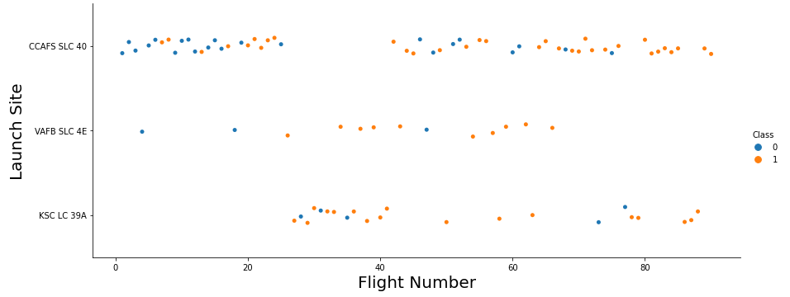
Flight Number vs. Launch Site
We observe that for each site, the higher the FlightNumber, the higher our chance of success.

Slide 19
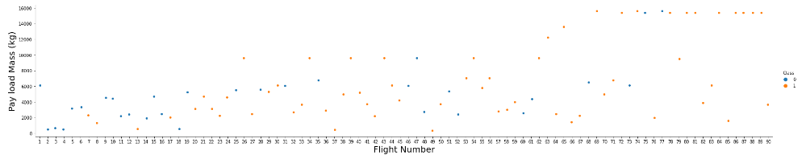
Payload vs. Launch Site
We see that different launch sites have different success rates. CCAFS LC-40, has a success rate of 60 %, while KSC LC-39A and VAFB SLC 4E has a success rate of 77%

Slide 20
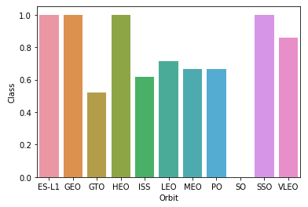
Success Rate vs. Orbit Type
We have average launch success following different orbit

Slide 21
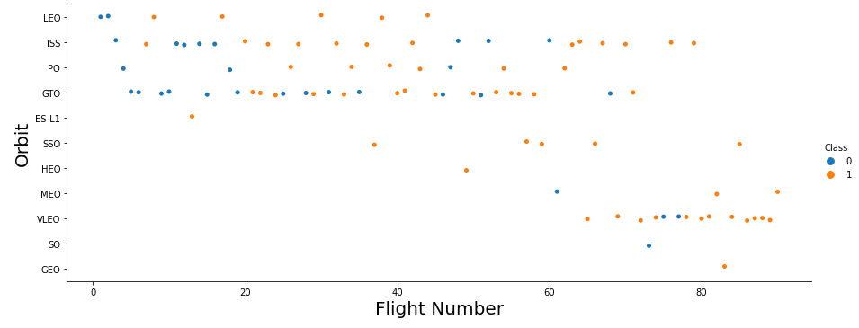
Flight Number vs. Orbit Type
For all orbits, the higher the FlightNumber, the better the result

Slide 22
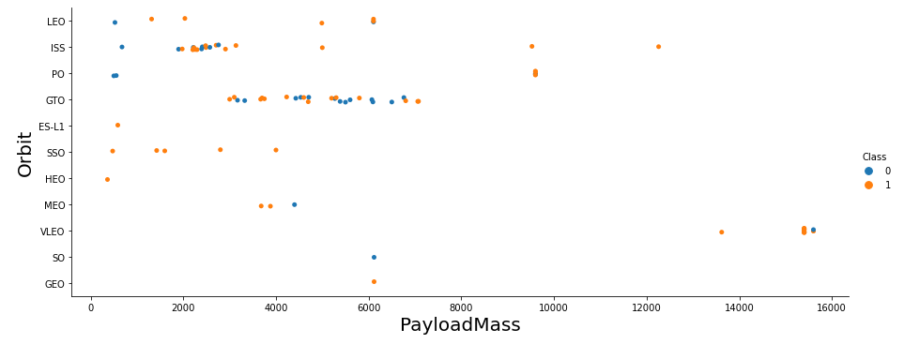
Payload vs. Orbit Type

Slide 23
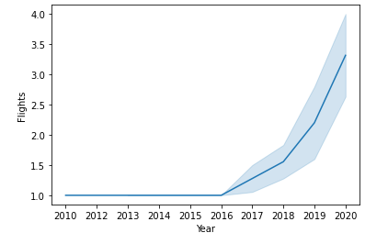
Launch Success Yearly Trend
The number of Flights has increased over time. and we experienced strong growth from 2016

Slide 24
All Launch Site Names
Launch_Site:
CCAFS LC-40
VAFB SLC-4E
KSC LC-39A
CCAFS SLC-40
Query: select distinct "Launch_Site" from spacextbl

Slide 25
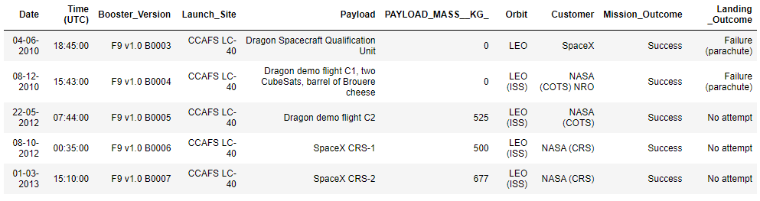
Launch Site Names Begin with 'CCA'
Query: select * from spacextbl where "Launch_Site" like "CCA%" limit 5

Slide 26
Total Payload Mass
Total_payload: 45596
Query: select sum("PAYLOAD_MASS__KG_") total_payload from spacextbl where Customer='NASA (CRS)'

Slide 27
Average Payload Mass by F9 v1.1
Average: 2534.66
Query: select avg("PAYLOAD_MASS__KG_") avg from spacextbl where "Booster_Version" like 'F9 v1.1%'

Slide 28
First Successful Ground Landing Date
Date: 01-05-2017
Query: select min(date) first from spacextbl where "Landing _Outcome" like 'Success (ground pad)%'

Slide 29
Successful Drone Ship Landing with Payload between 4000 and 6000
Booster_Version
F9 v1.1
F9 v1.1 B1011
F9 v1.1 B1014
F9 v1.1 B1016
F9 FT B1020
F9 FT B1022
F9 FT B1026
F9 FT B1030
F9 FT B1021.2
F9 FT B1032.1
F9 B4 B1040.1
F9 FT B1031.2
F9 FT B1032.2
F9 B4 B1040.2
F9 B5 B1046.2
F9 B5 B1047.2
F9 B5 B1046.3
F9 B5 B1048.3
F9 B5 B1051.2
F9 B5B1060.1
F9 B5 B1058.2
F9 B5B1062.1
Query: select Booster_Version from spacextbl where "Mission_Outcome"="Success" and "PAYLOAD_MASS__KG_" between 4000 and 6000

Slide 30
Total Number of Successful and Failure Mission Outcomes
Mission_Outcome | nbr
Failure (in flight) | 1
Success | 98
Success | 1
Success (payload status unclear) | 1
Query: select "Mission_Outcome", count(date) nbr from spacextbl group by "Mission_Outcome"

Slide 31
Boosters Carried Maximum Payload
Booster_Version
F9 B5 B1048.4
F9 B5 B1049.4
F9 B5 B1051.3
F9 B5 B1056.4
F9 B5 B1048.5
F9 B5 B1051.4
F9 B5 B1049.5
F9 B5 B1060.2
F9 B5 B1058.3
F9 B5 B1051.6
F9 B5 B1060.3
F9 B5 B1049.7
Query: select "Booster_Version" from spacextbl where "PAYLOAD_MASS__KG_" in (select max("PAYLOAD_MASS__KG_") from spacextbl)

Slide 32
2015 Launch Records
month | Booster_Version | Launch_Site
01 | F9 v1.1 B1012 | CCAFS LC-40
04 | F9 v1.1 B1015 | CCAFS LC-40
Query: select substr(Date, 4,2) month, "Booster_Version", "Launch_Site" from spacextbl where substr(Date,7,4)='2015' and "Landing _Outcome" = "Failure (drone ship)"

Slide 33
Rank Landing Outcomes Between 2010-06-04 and 2017-03-20
Rank the count of landing outcomes (such as Failure (drone ship) or Success (ground pad)) between the date 2010-06-04 and 2017-03-20, in descending order
Present your query result with a short explanation here

Slide 34

Section 3

Slide 35
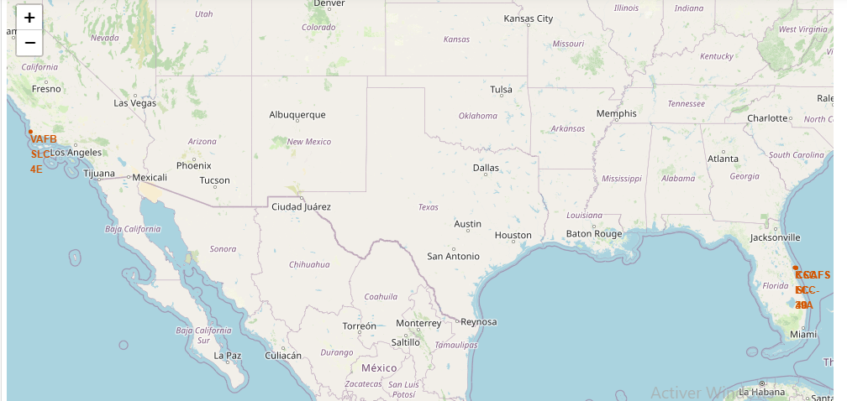
Mark all Launch Sites on the map

Slide 36
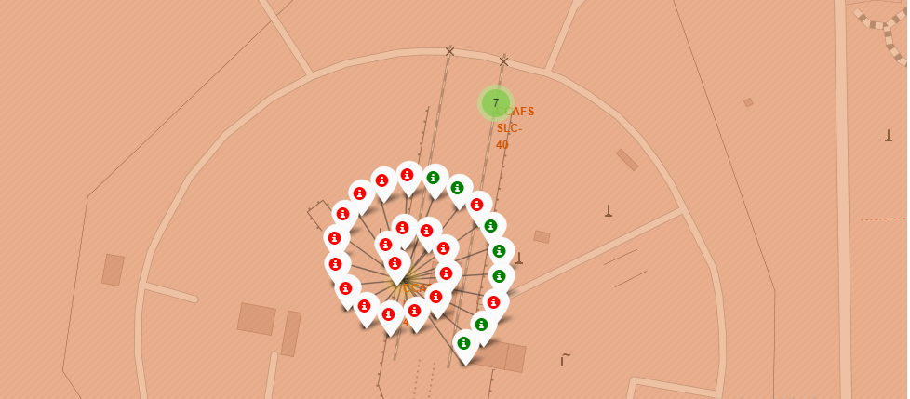
Mark the success/failed launches for each site on the map

Slide 37
Calculate the distances between a launch site to its proximities
Replace <Folium map screenshot 3> title with an appropriate title
Explore the generated folium map and show the screenshot of a selected launch site to its proximities such as railway, highway, coastline, with distance calculated and displayed
Explain the important elements and findings on the screenshot

Slide 38

Section 4

Slide 39
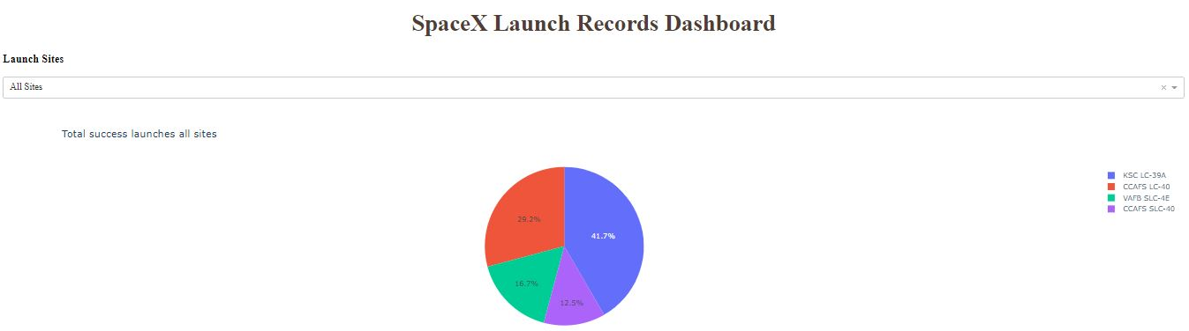
Total success launches all sites
We can see that the one with the best rate is KSC LC-39A

Slide 40
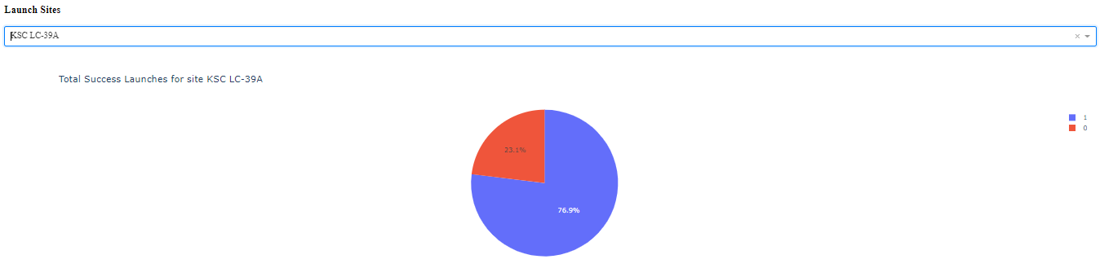
Total Success launches for site KSC LC-39A
We observe that this site has a success rate of more than 75%

Slide 41
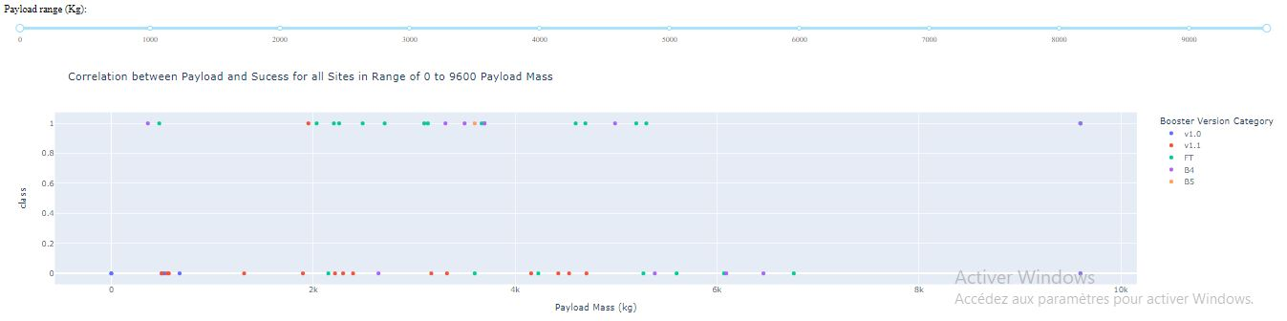
Correlation between Payload and Success

Slide 42

Section 5

Slide 43
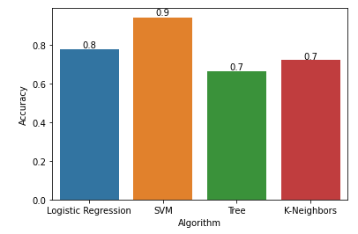
Classification Accuracy
According to the graph opposite, we can easily deduce that Support Vector Machine has better accuracy than other algorithms.

Slide 44
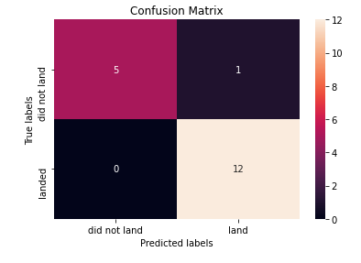
Confusion Matrix
The algorithm has a better prediction when the operation is a success, but on the other hand, the prediction is worse when it is a failure

Slide 45
Conclusions
Our purpose was to predict whether the Falcon 9 first stage will land successfully
we answered it following this route plan:
Data Collection (Through REST API)
Data Wrangling
Exploratory Data Analysis through SQL Queries, Visualization
Overview different site of launch on the map
Built an interactive dashboard for more overview
Built, fit and test several prediction model and find the best
We can conclude that launch success depends on several variables and the reuse of certain parts for launches is possible.

Slide 46
Appendix

Slide 47


